Slide 1
FACIAL AUTHENTICATION IN ATTENDANCE MONITORING
Team Details
G. MOHAN(20EG105213)
Y. SUSHMA(20EG105252)
CH. MANOJ(20EG105255)
Project Supervisor
Mr. V Amarnadh
Asst. Professor

Slide 2
Introduction
Facial authentication in attendance monitoring is a modern technological solution that leverages facial recognition algorithms to accurately identify and verify individuals for the purpose of recording attendance.
This system utilizes advanced computer vision techniques to analyze unique facial features such as the arrangement of eyes, nose, mouth, and other facial characteristics to authenticate the identity of individuals.
Facial authentication offers a more efficient, accurate, and convenient alternative. By simply capturing an image or video of a person's face using a camera, the system can quickly match it against pre-registered facial templates in a database.

Slide 3
Problem Statement
The traditional methods of attendance monitoring face issues of accuracy and security, with challenges like buddy punching.
To overcome these, facial authentication emerges as a solution. However, implementing this technology introduces concerns about privacy, algorithm biases, and usability.
This problem statement aims to address these challenges and establish a secure and user-friendly facial authentication system for attendance monitoring.

Slide 4
Problem Illustration
Develop and implement an advanced facial authentication system for attendance monitoring to enhance accuracy, security, and user experience.
Focus on addressing privacy concerns, mitigating algorithmic biases, improving usability, implementing anti-spoofing measures, enabling real-time processing, ensuring scalability, defining performance metrics, and providing user training for seamless integration with existing systems.

Slide 5
Proposed Method
User Registration:
Upon accessing the system, users are prompted to register by providing necessary information, including name, email, and student ID.
The registration process involves validation of user inputs and secure storage of user data in the system database.
Image Capture for Training:
To train the face recognition model, live images of students' faces are captured using the system's webcam module.
A dedicated interface allows students to position their faces within the camera frame, ensuring optimal image quality and coverage.
The capturing process is automated and guided, prompting students to maintain a neutral expression and adjust their positions as necessary for optimal image capture.

Slide 6
Proposed Method
Face Recognition:
Once images are captured, they are processed using the face recognition libraries(ssim) to extract facial features and generate face embeddings.
These embeddings are then used to train the face recognition model, employing techniques such as deep learning-based feature extraction and classification.
During attendance marking, the trained model is utilized to recognize faces in real-time, matching them against the stored embeddings to identify individuals accurately.
Attendance Marking:
Upon successful recognition, the system records the student's in or out timestamp, along with relevant metadata such as student ID.
Attendance data is logged securely and stored in the system database for future reference and analysis.

Slide 7

Experiment Screen shorts

Slide 8
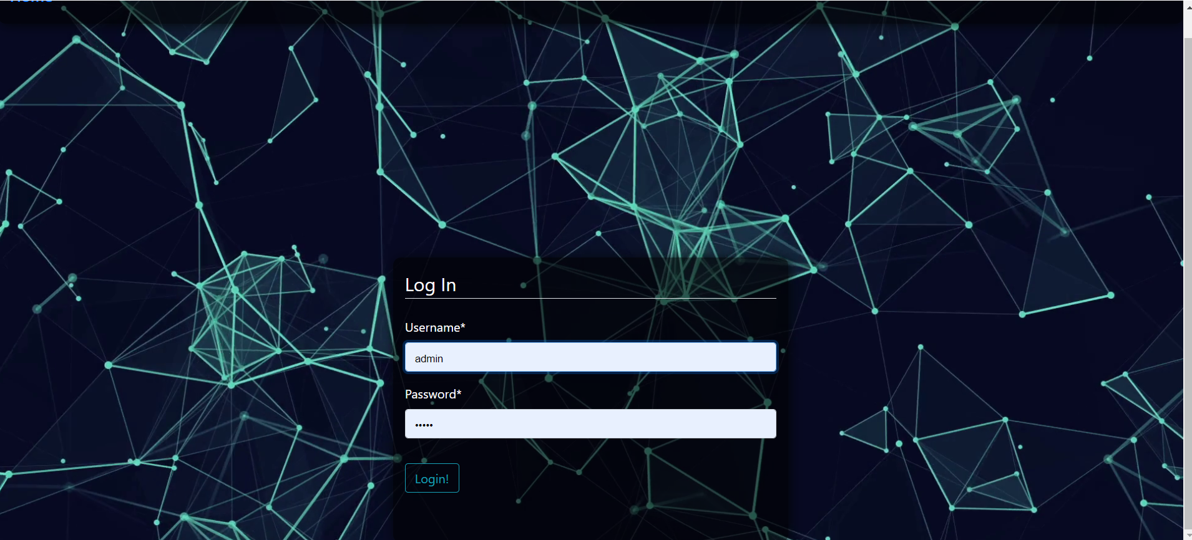
Experiment Screen shorts

Slide 9
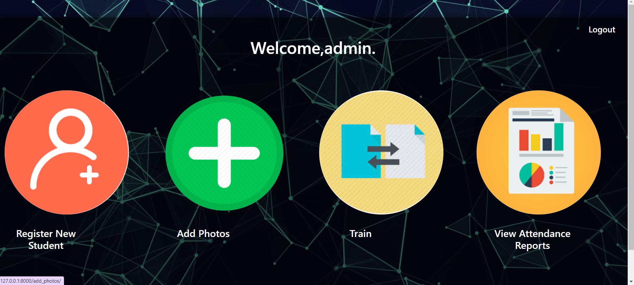
Experiment Screen shorts

Slide 10

Experiment Screen shorts

Slide 11

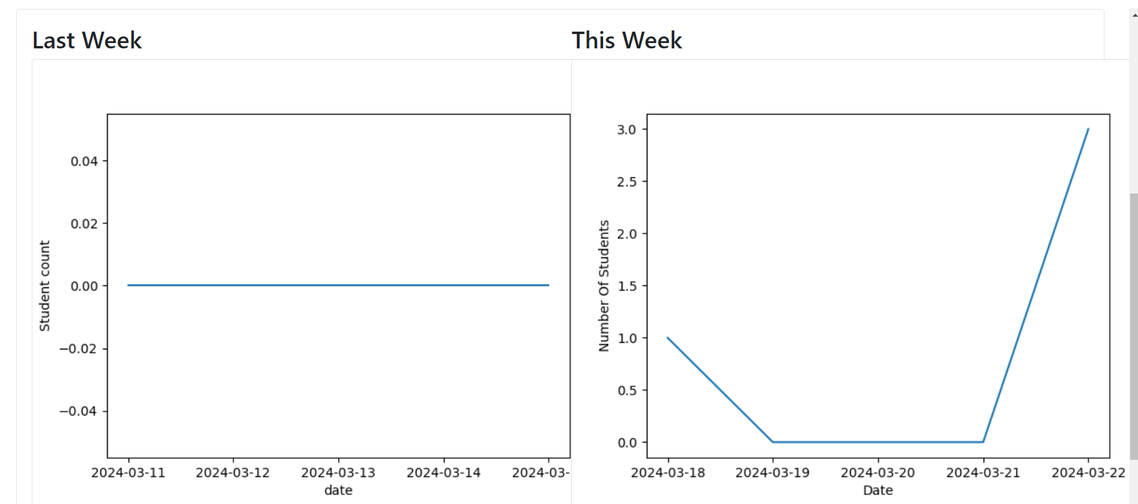
Experiment Screen shorts

Slide 12
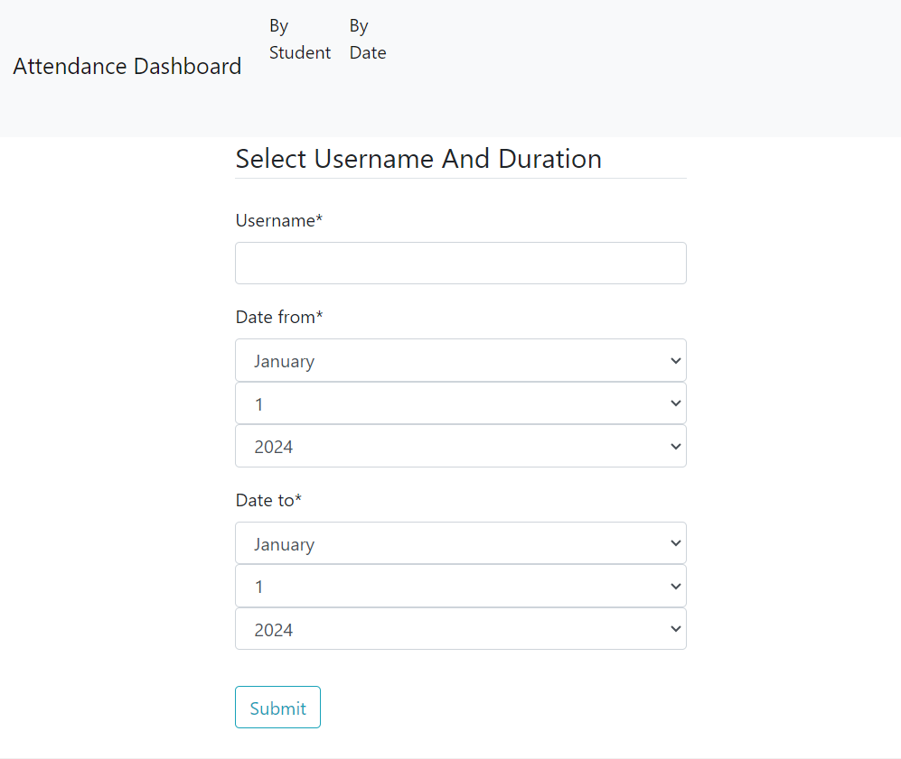
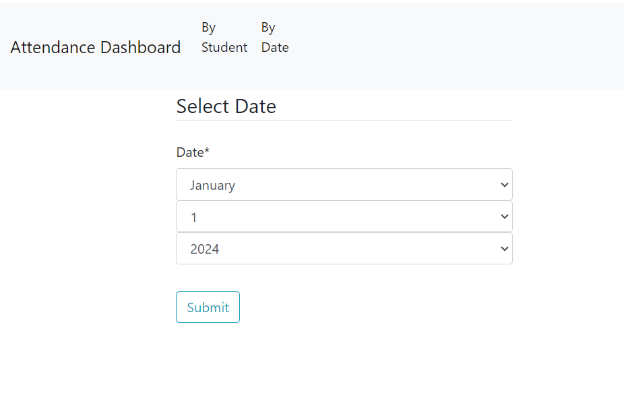
Experiment Screen shorts

Slide 13
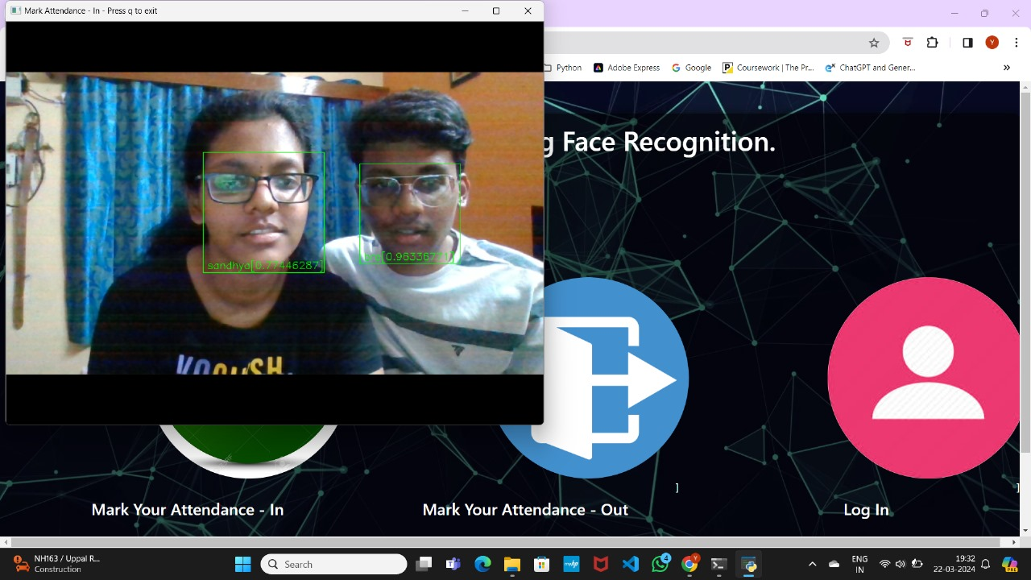
Experiment Results

Slide 14
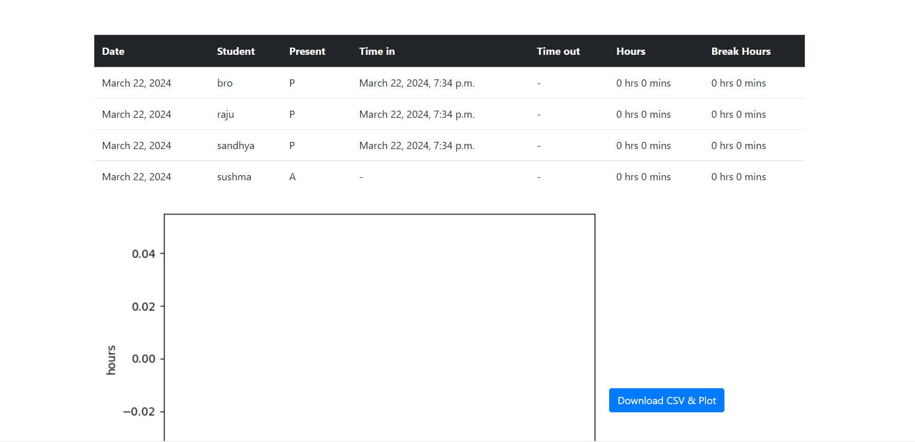
Experiment Results

Slide 15

Experiment Results

Slide 16
Justification
1.What are parameters improved by your method?
provide a robust, accurate, and efficient solution for attendance management.
2.Mathametic formulas for calculating parameter values
Principal Component Analysis (PCA)
Euclidean distance
Support Vector Machines (SVMs)

Slide 17
Thank You

